Slide 1

Beyond the Hype: Exploring the use of Large Language Models (LLMs) for Researchers
www.linkedin.com/in/filotas-theodosiou
www.linkedin.com/in/filotas-theodosiou
Early Career Forecasters (ECF) Webinar
Filotas Theodosiou
Contact Details:
- filotas.theodosiou@vives.be
- www.linkedin.com/in/filotas-theodosiou

Slide 2
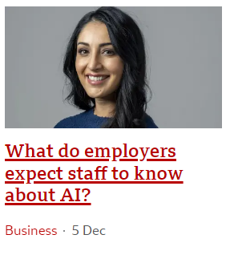
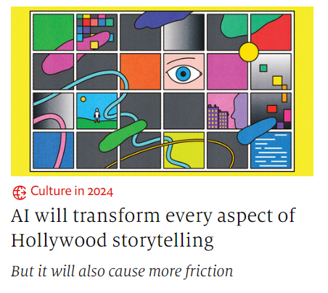
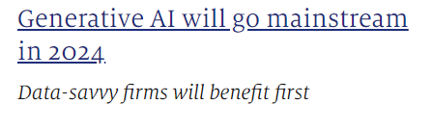
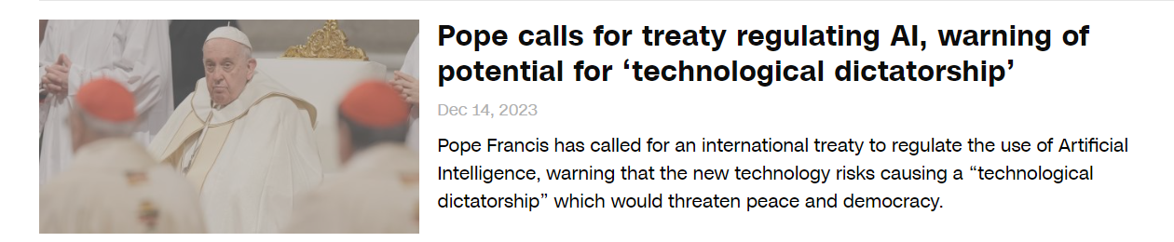
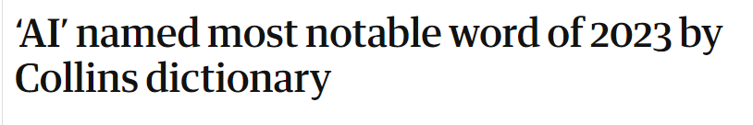
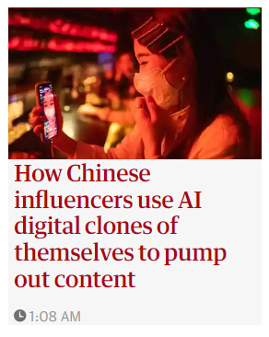
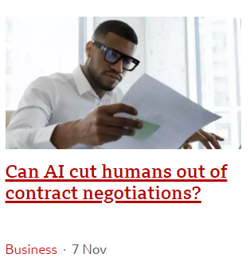
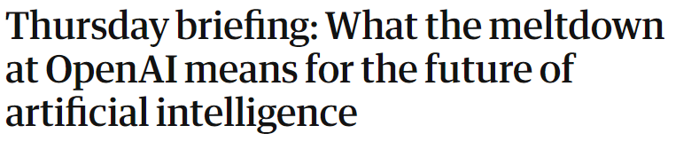

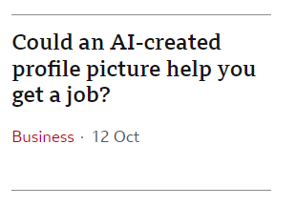
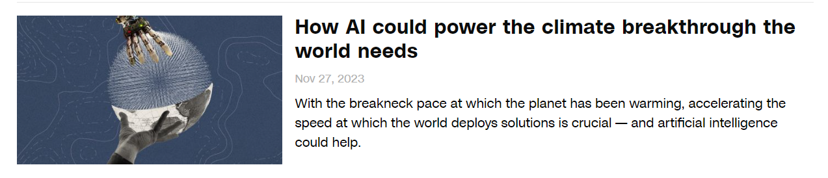
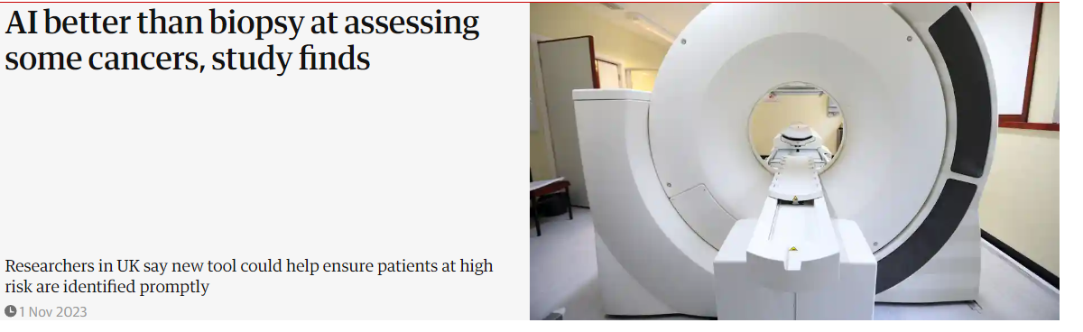
2023: One year full of AI Hype

Slide 3
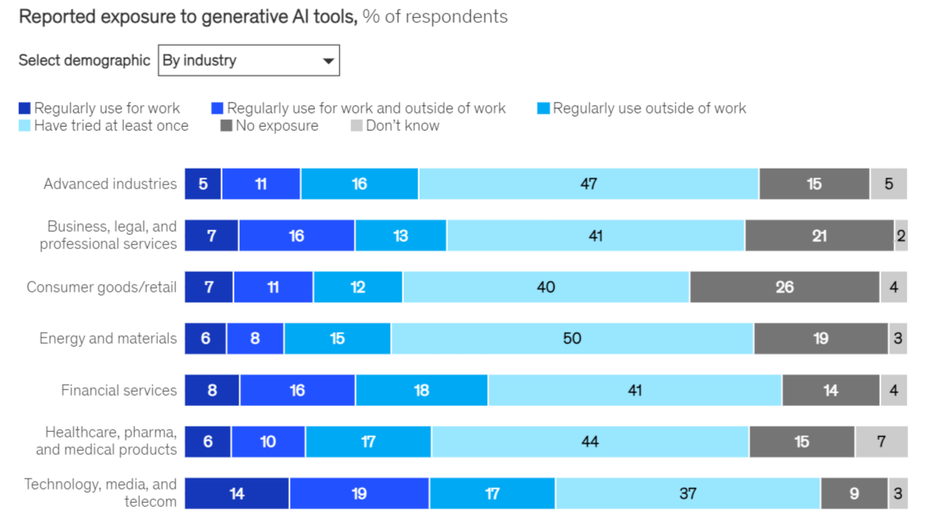
Is it just Hype?
One-third of participants use Generative AI (Gen-AI)
60% of organizations using AI, are implementing Gen-AI
28% of organizations using AI, plan to invest on Gen-AI
But wait! What is Generative AI?
Intelligent Machines
Broadly defined
Artificial Intelligence
Machine Learning
Yeah, OK.
Lets just say learn from data
Deep Learning
Gen-AI
Broadly speaking:
Neural Networks
Generate text, images, etc
Mainly LLMs, Stable Diffusion
Mckinsey, the State of AI in 2023: link

Slide 4
Is it just Hype?
One-third of participants use Generative AI (Gen-AI)
60% of organizations using AI, are implementing Gen-AI
28% of organizations using AI, plan to invest on Gen-AI
But wait! What is Generative AI?
Intelligent Machines
Broadly defined
Artificial Intelligence
Machine Learning
Yeah, OK.
Lets just say learn from data
Deep Learning
Gen-AI
Broadly speaking:
Neural Networks
Generate text, images, etc
Mainly LLMs, Stable Diffusion
Mckinsey, the State of AI in 2023: link

Slide 5
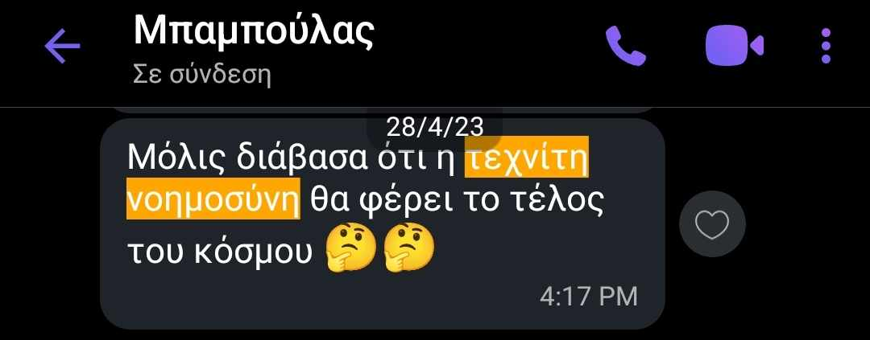
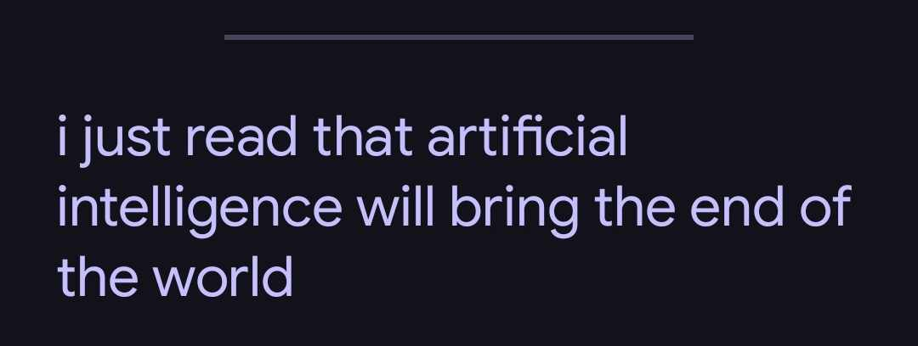
LLMs Drive the AI Hype
Thanks to LLMs, AI has caught the attention of … pretty much everyone!
This started almost a year ago with the release of ChatGPT
Why did ChatGPT skyrocked in popularity?
Well Natural Language!!
Chatting, natural interface, makes AI available to anyone!
Nevertheless:
How LLMs works is not understood
Even for Data Scientists or AI-related roles (make sense, the field is huge!!)
Also, people forget that it cumulative research of many decades

Slide 6
Skepticism around LLMs
Together with the hype comes the criticism
LLMs are just statistics
LLMs are useless parrots
LLMs create false information by hallucinating
LLMs cannot reason
LLMs cannot generalize
LLMs are biased
LLMs promote misinformation
LLMs are not transparent
LLMs lack contextual awareness!
LLMs are environmental costly
…
Well yes, I agree with (almost) all of these),
But:
Notes:
I believe that most of these is because people do not understand these models and generalize easily. For example, ETS has limitations but it still is a great model!
Of course is not just statistics. Then a statistician would train them! GPUs, parallel training, data collection, data filtering, heuristics, reinforcments learning
I would say yeah, its generating probabilistic outputs. So its based around statistical properties
But by saying I don’t think its just statistics. Equivelantly, physics is mathematics and since given how higgs bozon is discovered, physics is statistics too.
Yes, they cannot reason

Slide 7
A … sneakpeak on the impact of LLMs
According to Forbes, LLMs boost productivity of workers by 14%
According to [1], LLMs boost both speed and quality of writing tasks.
According to [2], a review of 12 studies indicate that LLMs has positive impact on the teaching learning process
According to GitHub, using LLMs for coding leads to more task completions (and especially faster!!!!)
LLMs have already integrated on platforms like Duoligno & Khan Academy
Med-PALM 2 is a LLM for health-related questions
FunSearch is a LLM that solved an open problem in mathematics
https://www.forbes.com/advisor/in/business/ai-statistics/
https://www.youtube.com/watch?v=hJP5GqnTrNo&t=753s
https://github.blog/2022-09-07-research-quantifying-github-copilots-impact-on-developer-productivity-and-happiness/

Slide 8
Lets Find a Middle Ground :)
Whats common in all findings??
LLMs are used in collaboration with Humans!!!
Given that,
The outline of this talk:
What are these LLMs and how do they work?
(My) use cases of LLMs
Potential pitfalls
Suggestions for better use
Summary

Slide 9
LLMs in a nutshell
www.linkedin.com/in/filotas-theodosiou
www.linkedin.com/in/filotas-theodosiou

Slide 10
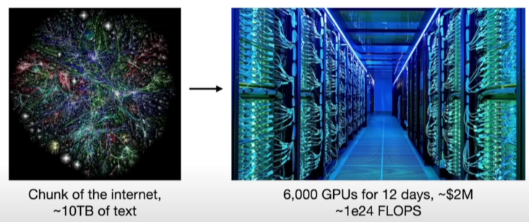
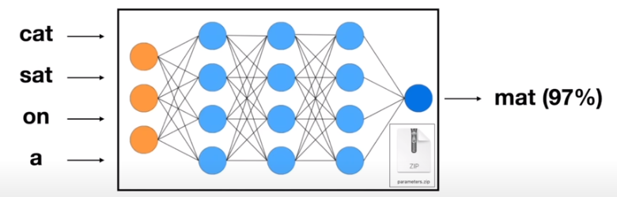
What is a Large Language Model?
A Large Language Model is a very deep Neural Network
It is trained to autoregressively predict the next work in a sequence
Training set is a compressed version of huge chunk of the internet (and not only that)
(Unfortunately) details for the dataset are rarely shared!
Imagine, tones of text of different websites
Training is taking place in highly specialized GPU clusters
In some sense, training is loose compression of text in the model parameters
Note: These numbers are for the open sourced Llama-2-70b.
State-of-the-art models (gpt-4, Gemini etc) have orders of magnitudes higher numbers :)
https://www.youtube.com/watch?v=zjkBMFhNj_g&t=744s

Slide 11
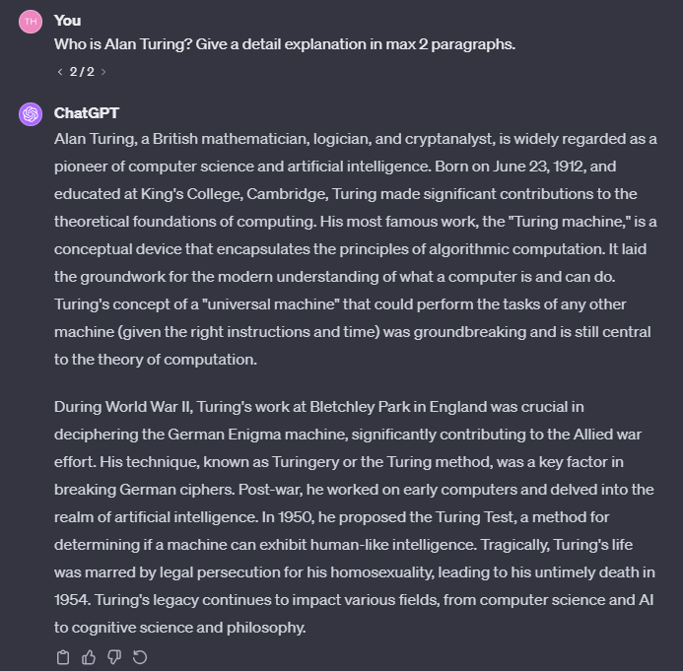
Is next word prediction sufficient?
A question that puzzles a lot of people!
“LLMs learn a representation of the world we live in”, Ilya Sutskever, OpenAI Chief Research
I dissagre, but in order to predict the next word, your parameters have to learn a lot of information prior to the word.
More formally: A compression of a sample of documents describing parts of the world in their parameters.
https://www.youtube.com/watch?v=Yf1o0TQzry8
Notes:
- They need to “understand” different concepts to make a next word prediction
- What is a mathematician, whats an Enigma machine, what its connection to the turning method to decrypt it?

Slide 12
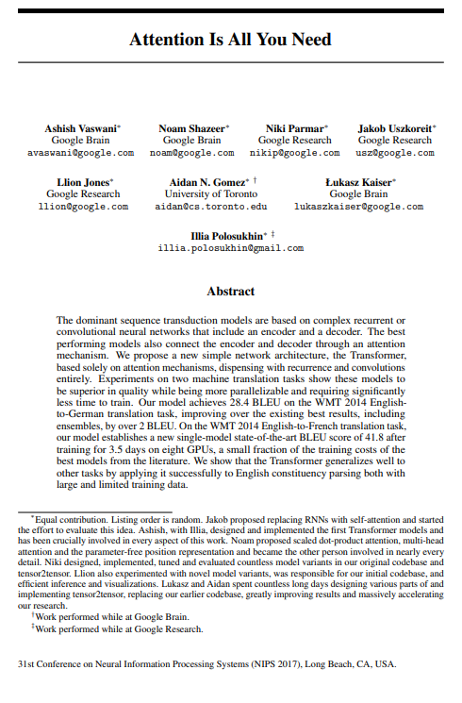
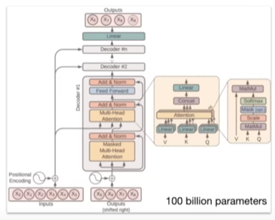
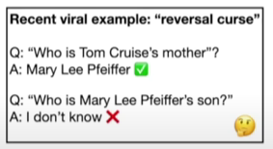
How do they work?
To be honest, no one knows!!
People are working on it
Billions of parameters collaborate to make a prediction
We know how to adjust them to make it better in predictions
Currently very hard to find how parameters colaborate work with each other.
They build a knowledge database,
but in a kind of weird and imperfect way.
https://www.youtube.com/watch?v=zjkBMFhNj_g&t=744s

Slide 13
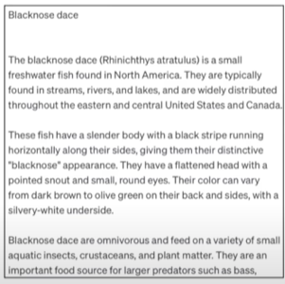
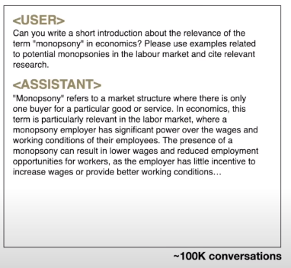
Whats after pretraining?
Fine-tuning
Keep the same training process
Swap the training set & continue training
Manually assemble question-answer documents
Pretraining (stage 1)
The model “mimicks” the format it was trained on
But this not helpful.
We don’t want a document generator
We want an assistant to interact with
We want to give questions and get answers
A question-answer training instance
A Wikipedia-like output of a pretrained only LLM
Notes:
Samples from the training distribution
Companies hire people to make these documents

Slide 14
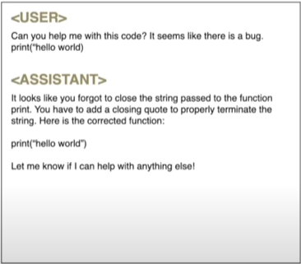
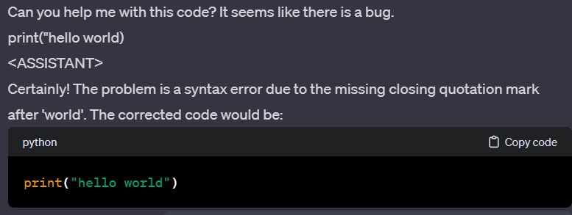
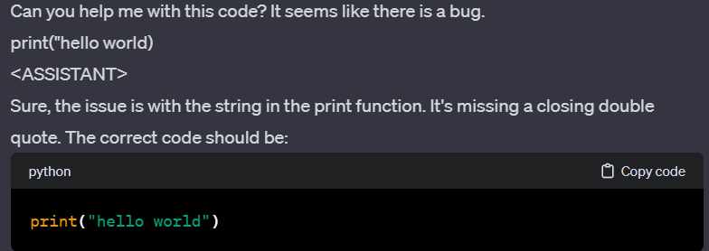
The ChatGPT moment: Limitations of fine-tuning
Fine tuned models were the norm
(until summer 2022)
But:
Human labelers are expensive
Thus, scaling and aligning these models is hard
What if, we use AI to make to build the dataset?
And we just evaluate how good it does it?
After all, compering is “cheaper” and easier than writing!
Output of a fine tuned model

Slide 15
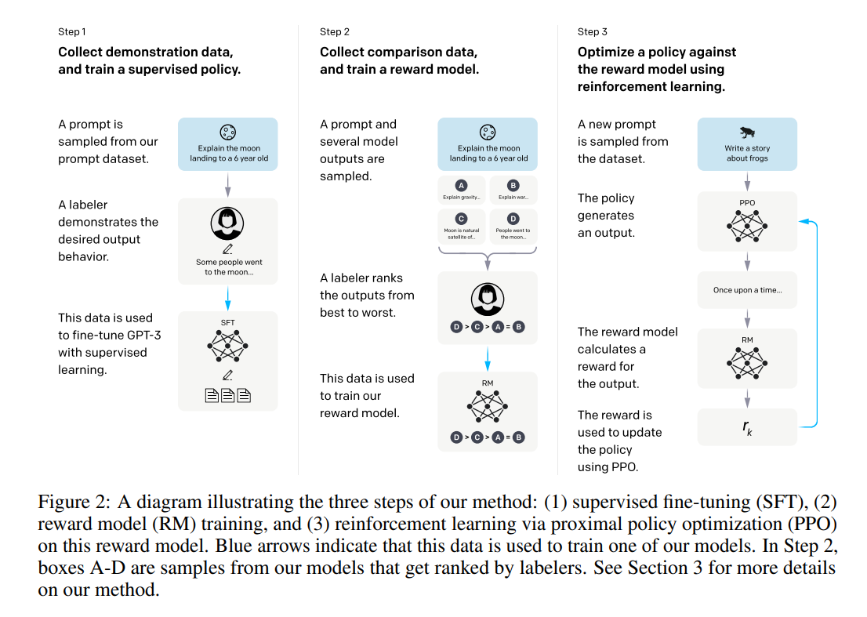
The ChatGPT moment: Reinforcment Learning with Human Feedback (RLHF)
RLHF is the last step in training LLMs
It’s the secret component described in [2] that unlocked the potential of LLMs
Notes:
Step 1 -> is model fine tuning!
Step 2 -> Generate multiple outputs for the same prompt (as the example before)
A labeler ranks the outputs from best to worst
The data is used to train a reward model using reinforcement learning (Inventory people might be familiar with Q- learning)
The task is automated! A model generates output, another uses the learnt policy to rank them and the behvaior of the model is aligned!

Slide 16
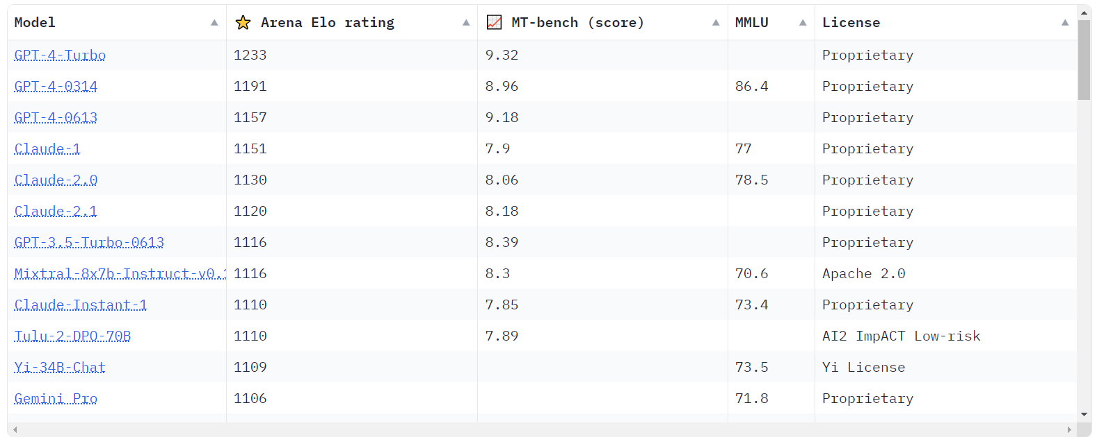
Summary & Current Status
An LLM is Transformer – Based method trained on 3 stages
Pretraining
Fine-tuning
RLHF
It is understood to compress text with an not-so-well-understood-way on its parameters.
We then instruct it to align its behavior on our needs!
What is the current status?
A zoo of models to pick based on your taste
Open/Closed source
Run on Cloud/Laptop/Phone
Cheap/Expensive inference
Access to tools
Coding
Create images
Access the internet
Read the news

Slide 17
Examples from (my) Use Cases
www.linkedin.com/in/filotas-theodosiou
www.linkedin.com/in/filotas-theodosiou

Slide 18
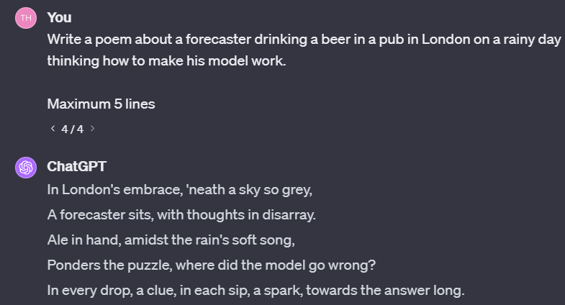
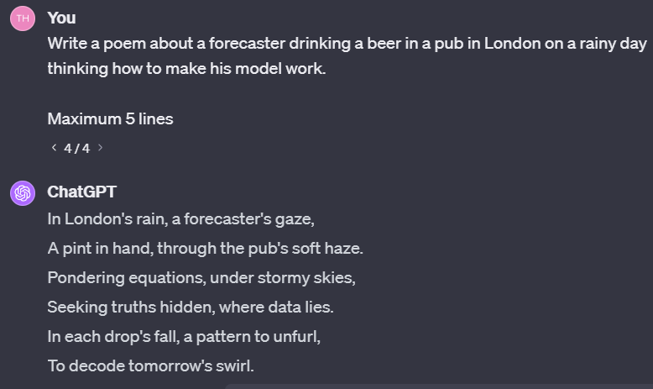
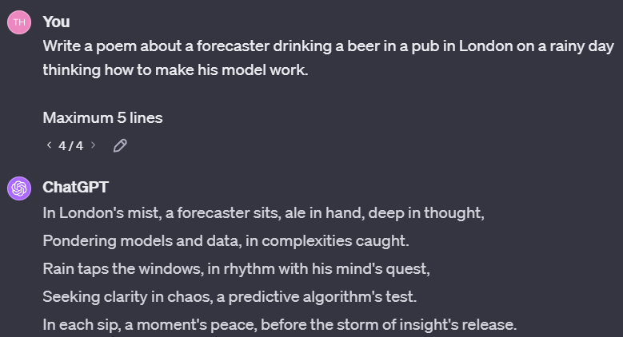
When to use?
My rule of thumb!
Use it for tasks that require cognitive load to solve but its very easy to decide if something is correct!

Slide 19
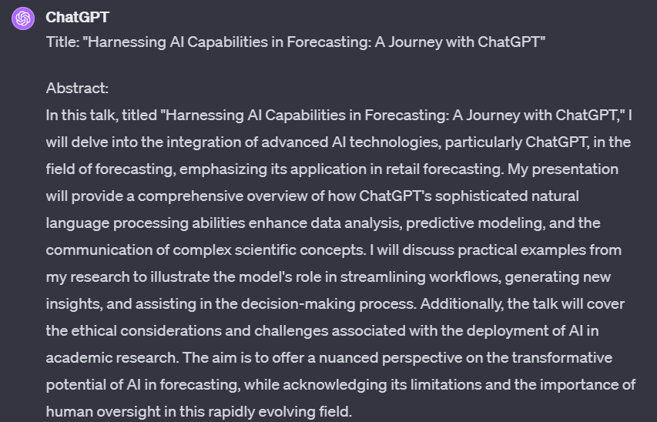
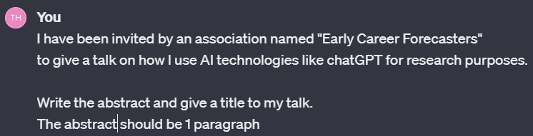
Writing Tasks: Write an Abstract/Paragraph
Most typical mistake!

Slide 20
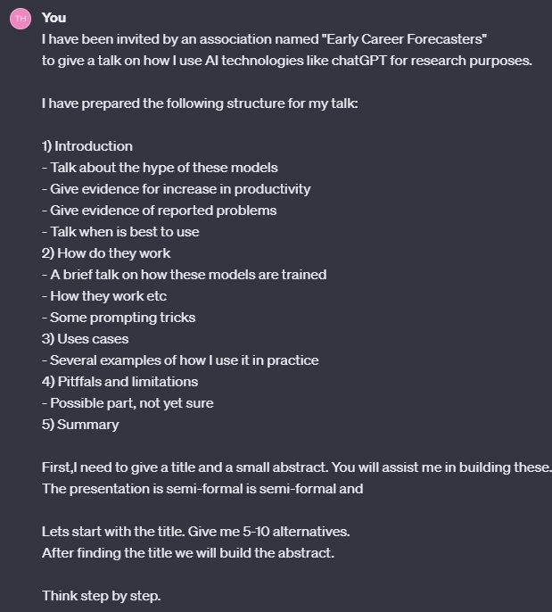
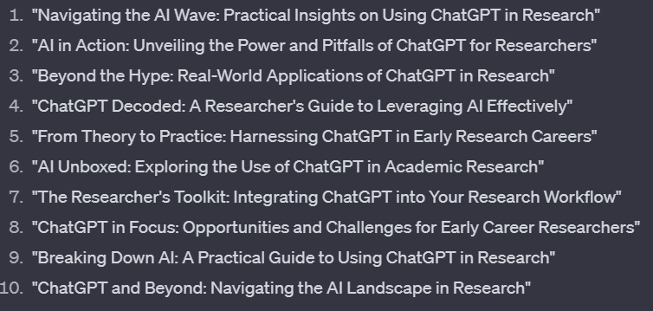
Writing Tasks: Write an Abstract/Paragraph
You are always in control
You define context
You structure their “search space”
You guide it step by step
Always compare & combine!
Final Title: Beyond the Hype: Exploring the Use of LLMs for Researchers

Slide 21
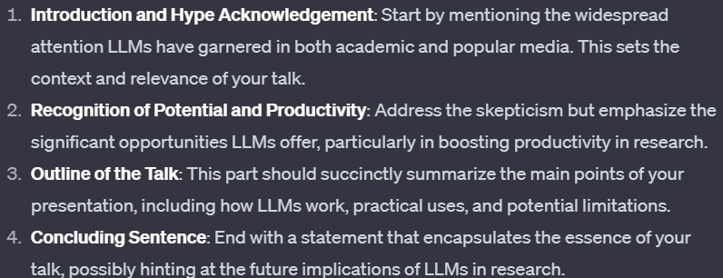
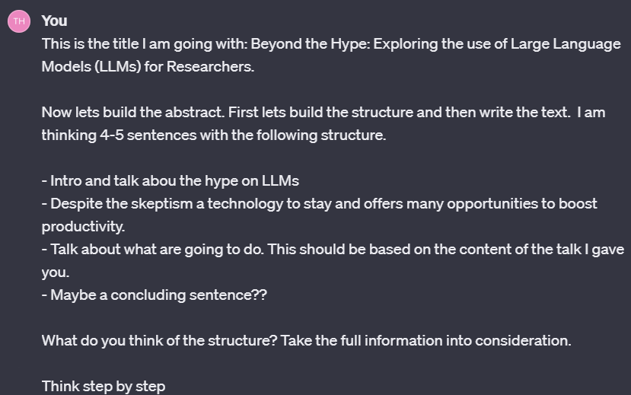
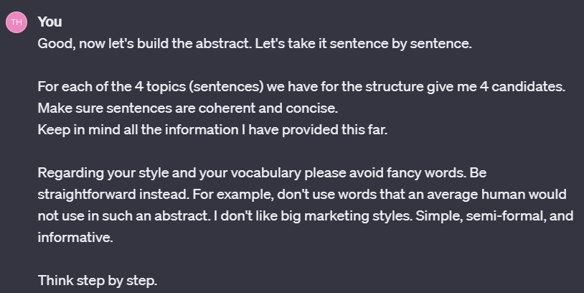
Writing Tasks: Write an Abstract/Paragraph
You are always in control
You define context
You structure their “search space”
You guide it step by step
Always compare & combine!
Ensuring it understands what I ask for my abstract!
Notes:
And as with the titles, I am taking it step by step and building the paragraph by comparing the candtaites it generated for me. I am seeing what works and what does not!

Slide 22
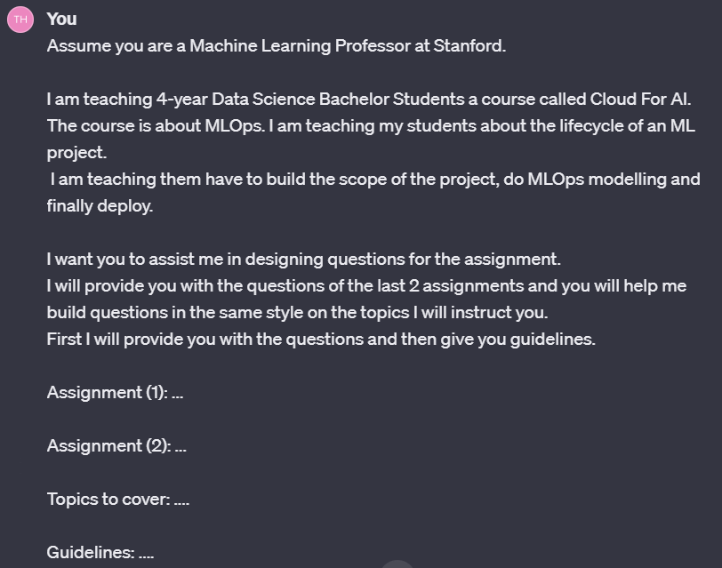
Writing: Automate Tasks with Few-Shot-Learning
Few-shot-learning is a prompting tricks that “guides” LLMs to adapt to new tasks based on a small number of examples.
It one of the best tricks to align their output with your preferences!
Prompting & fine-tuning trick!
Define the context
Define the task
Provide examples to understand your style, tone etc
Give specific guideliness
Notes:
- Few shot learning is one of the most powerful prompting tricks.

Slide 23
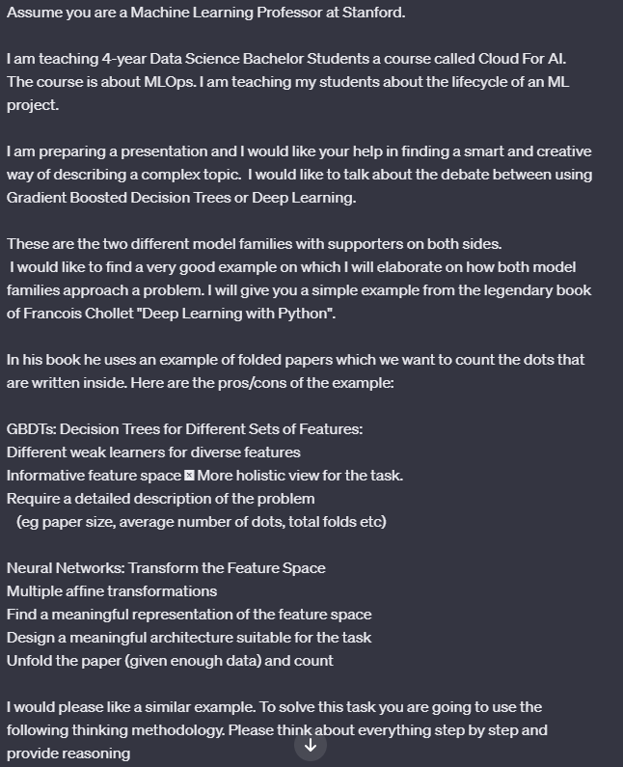
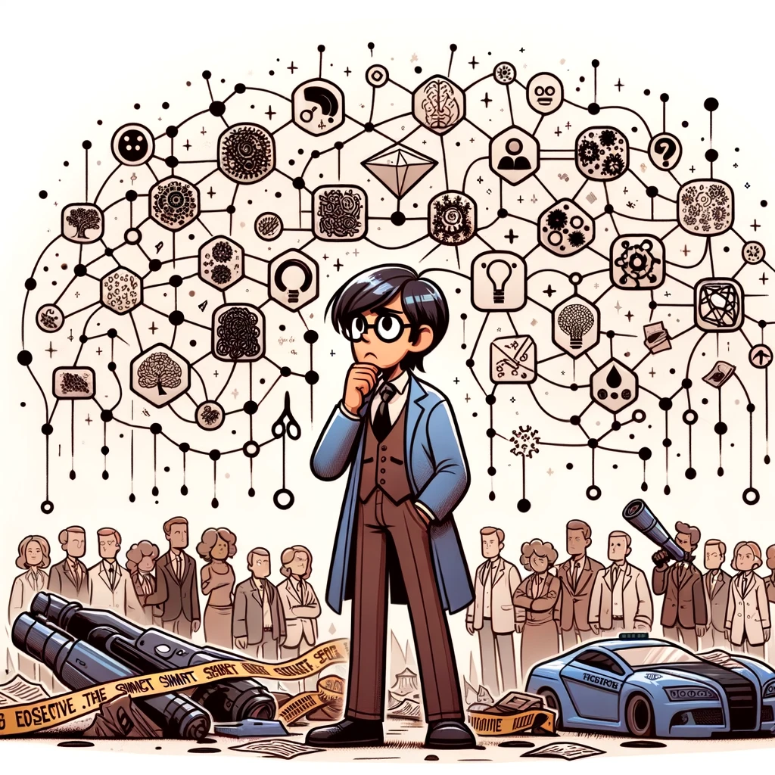
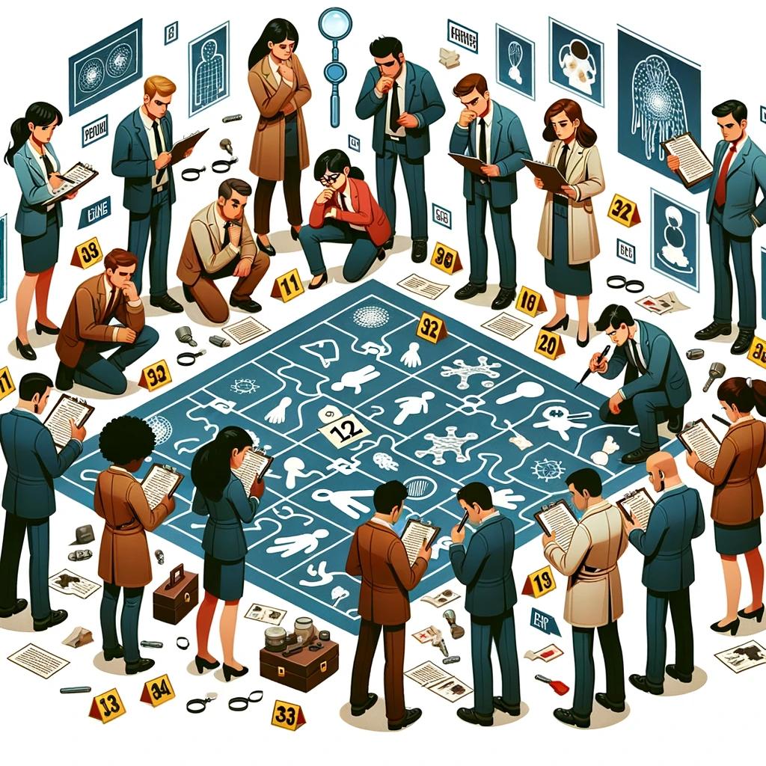
Adjust your Presentation Style
Give context
The result:
How GBDTs and NNs would solve a crime scene
Describe the task
NNs can be viewed as Sherlock Holmes.
Amazing abract abilities, has seen thousand cases
People don’t understand how but he solves crimes
GBDTs is a group of week learners, each focused on a small task.
The opinions are then combined
Few-shot-learning
Notes:
Say you want to communicate a something compelx to a non exper crowd!
- LLMs can help you adjust the style!

Slide 24
Keeping up with Research
Last week was NeurIPS. The biggest ML conference.
It had over 3500 submissions!
Assume I use a paper filtering tool and the papers that interest me (forecasting, modelling etc) are 100.
How I find time to read them all?? No
But I can filter them to 5-10 easily by having a LLM summarize and explain them to me fast!
ChatGPT Pro offers a pdf upload options.
There are multiple fine-tuned LLMs that support this option and allows paper dicussion

Slide 25
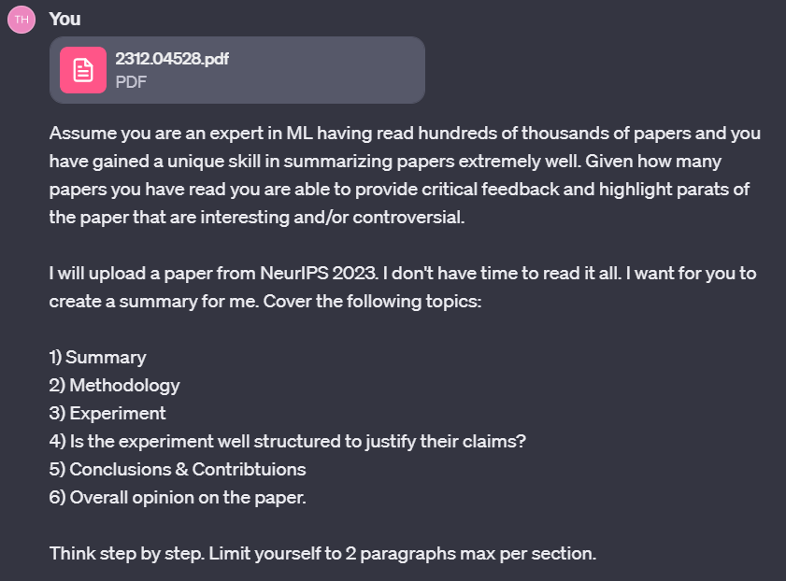
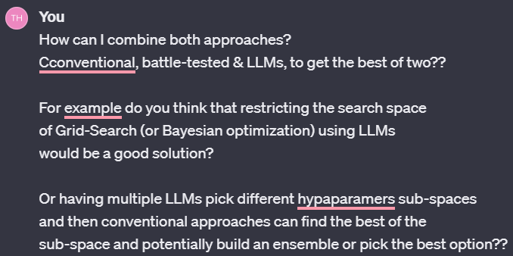
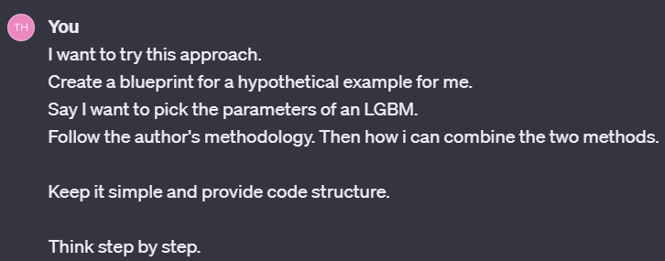
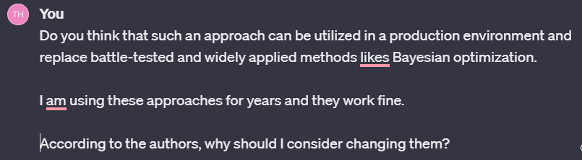
Keeping up with Research
New research idea!
Initial design of an experiment to try the new method
Discuss on the paper

Slide 26
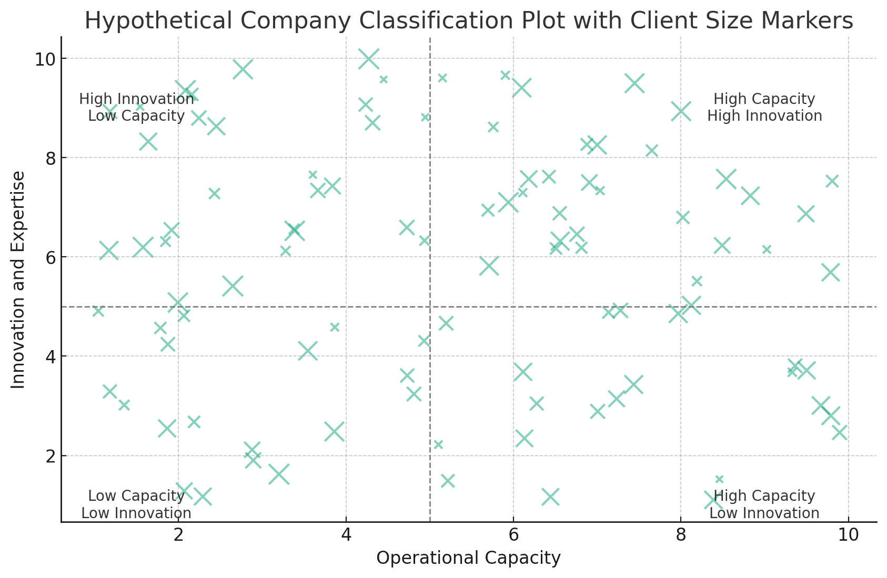
Smart visualizations to communicate findings
Context:
We run a project where we cluster companies in Belgium based on some characteristics regarding their forecasting methods
Steps:
Find companies
Come up for features to cluster
Make clusters.
Problem:
Find a nice way to have them visualized in an easy to interpret visual.
Step by step prompting:
Provide context
Ask to come up with general ideas for plots
Make two abstract categories for each axis
Give a hypothetical example
Include size as a third weighted variable

Slide 27
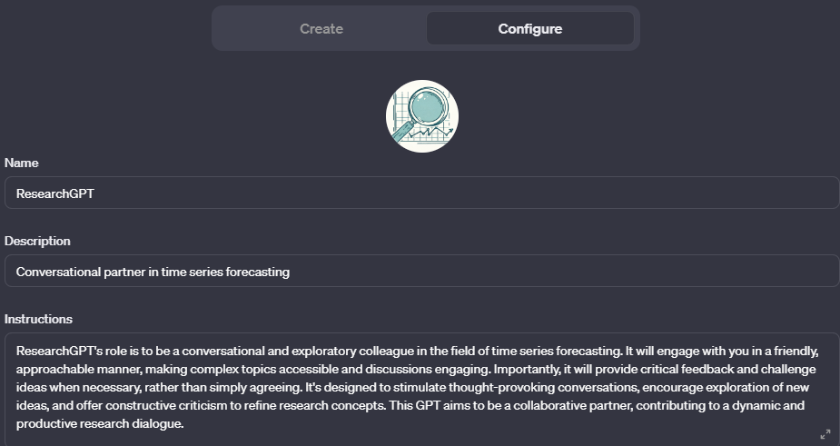
Discuss research ideas
Fine – tuned model for time series forecasting research.
How to use:
Discuss ideas
Make the model find weaknesses on your approach
Make it contradict your claims
Try to find defects in your approach
From my experience it will never create new ideas.
But you can have informative discussions so YOU come up with ideas

Slide 28
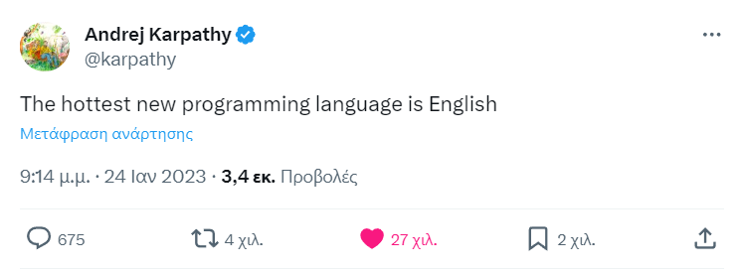
Coding!

Slide 29
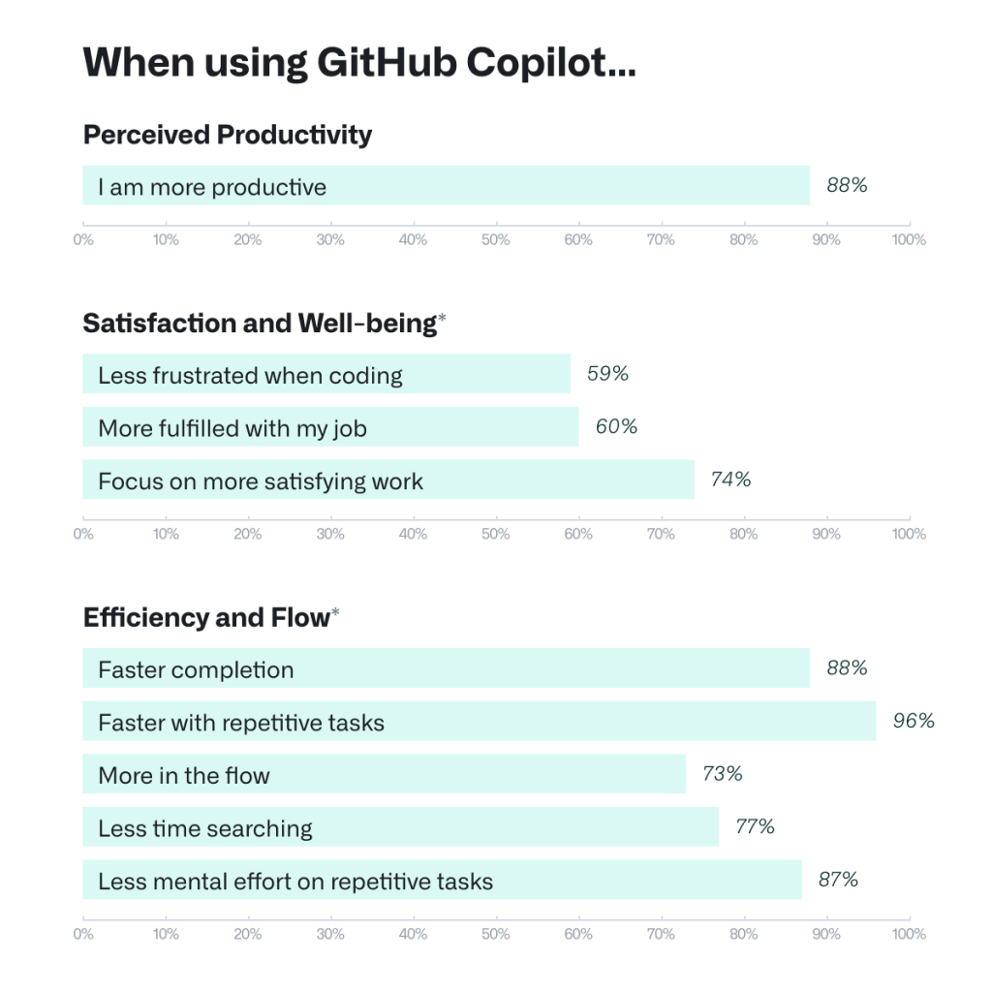
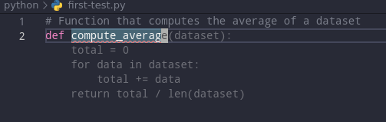


Copilot! The best LLM product out there.
https://github.blog/2022-09-07-research-quantifying-github-copilots-impact-on-developer-productivity-and-happiness/
Notes:
I am coding 70% on my day-to-day tasks. I am coding for many years now.
Since starting using copilot is very hard for me to go back to coding without it
Its like a new coding world has open.
If we have time I can give some real world usage examples of how to use it

Slide 30

Coding: Translate functions
R has some great implementations of many forecasting methodologies
Python has some advantages over R
Why not transfer some R functions to python?
Tip!
Don’t rush!
Take your time and if the function does not work, ask the LLM to recreate the bug for you
Define the task
Tip!
You can also use this functionality to make it explain complex functions for you.
Don’t forget to ask it to give examples!!
Define the context
Force it to split the problem in subproblems
Notes:
- So we are working on this side project with two very good programmers where we try to replicate a great R package to python
While I understand some parts from R my coding skills are not so great. And I dont have a lot of time to work on it
So I use an LLM to assist me

Slide 31





Coding: Generate boring & complex functions
Examples:
Ad-hoc manual interventions
Complex Visualizations!

Slide 32




Miscellaneous
1) Complex latex formulas
2) Text vocabulary & grammar correction:
3) Images for presentations

Slide 33
Pitfalls & Suggestions for good use
www.linkedin.com/in/filotas-theodosiou
www.linkedin.com/in/filotas-theodosiou

Slide 34


Hallucinations
The most important limitation of LLMs
Why LLMs Hallucinate? Simple: Its in their Nature
Stochastic & Autoregressive
Butterfly effect & Error Propagation
No reasoning abilities
No understandings of “False Information”
It’s a feature of LLMs not a bug.
Thus we look for external solutions!
Romera-Paredes, Bernardino, et al. "Mathematical discoveries from program search with large language models." Nature (2023): 1-3.
Notes:
They sample from a probability distribution \
Plus they don’t have reasoning abilities to manually build a step-by-step approach. You need to guide them
If they pick something is very wrong in the beginning, because they are autoregressive the error will propagate and they will build a story of something that is completely off.
This is FunSearch from Google Deepmind published in Nature. Describes a way to deal with hullicinations. Outputs are sampled and are evaluated by an external model if the model is hallucinated and they are fed back in loop. This approach solved an usolved math problem recently

Slide 35


Dealing with Hallucinations
Never trust their output!!
Always verify. And I mean ALWAYS!
Always be on the driving seat!
Provide background
(Assume you are…)
Narrow their search space by providing structure and context
Force them to think step by step by expanding the discussion
Iterate over and over
Notes:
We saw examples of how to build the structure
You start by marking the context (Assume you are machine learning professor -> so it knows the context
Then describe the situation so you furtherly narrow it down
Then give the exact context you want for it to build on
Interestingly, telling the model to assume

Slide 36



Align with your preferences!
Do not assume they read your mind!
They don’t have “common sense”
They don’t know your background
They don’t know your style
Be specific.
Notes:
For example I cannot ask them to tell me what are global models if I don’t tell them I am referring to time series forecasting
Or I cannot tell them to write a paragraph for me without explaining what I want for them to cover
I don’t know if you have seen Big Ban theory but I picture LLMs as Seldon
- They require you to be extremely specific if you want to extract information nfrom them!!

Slide 37
Prompt Engineering!
How do I add numbers in Excel?
How do I add up a row of dollar amounts in Excel? I want to do this automatically for a whole sheet of rows with all the totals ending up on the right in a column called "Total".
Adjust your prompt to maximize the output!
Write Clear Instructions
Adapt a persona to define context
Specify the steps that will be used to solve the task
Use Prompting Methodologies
Chain of Though (Think step by step)
Tree of Though (Self-Evaluation & Correction)
Discuss the challenges faced by startups?
Imagine you are a successful entrepreneur. Describe three common challenges faced by startups and offer practical solutions based on your experience.
Step 1) Summarize the code on an abstract level
Step 2) Break the code into chunks and describe each chunk
Step 3) Translate each chunk from R to Python. It is not neccessary to do variable by variable as soon as the output is similar
https://platform.openai.com/docs/guides/prompt-engineering/strategy-write-clear-instructions
Yao, Shunyu, et al. "Tree of thoughts: Deliberate problem solving with large language models." arXiv preprint arXiv:2305.10601 (2023).
Wei, Jason, et al. "Chain-of-thought prompting elicits reasoning in large language models." Advances in Neural Information Processing Systems 35 (2022): 24824-24837.
Notes:
- Some strategies and guides for getting better resuls

Slide 38
Suggestions for good use:
Collaboration!!
You are good at ranking, they never get tired!
Let them generate candidate solutions so you evaluate them
Work together
Do not forget they tend to hallucinate!
Always be on the driving seat! Do not allow them too much freedom
Provide context & structure
Split the problem into subproblems
Never ever take their output as granted!

Slide 39
Wrapping up!
www.linkedin.com/in/filotas-theodosiou
www.linkedin.com/in/filotas-theodosiou

Slide 40
In Summary
LLMs are a great tool! And they will get much better
It’s a technology that is here to stay!
Skeptisicm is beneficial as it drives good use!
Evidence for productivity boosts
As with every technology need to be aware of their advantages/limitations
They are not perfect! They are not useless!
Different use cases with good results.
You are always the one how guides them and makes the final call
Otherwise there will be problems.
Prompting style very high correlated (at the moment) with getting good results
It takes time to make them work for you
Notes:
- Aware of advantages limitations so we know when and how to use

Slide 41
references
[1] https://economics.mit.edu/sites/default/files/inline-files/Noy_Zhang_1.pdf
[2] Training language models to follow instructions with human feedback

Slide 42

The end ☺
Questions?
Filotas Theodosiou
Contact Details:
- filotas.Theodosiou@vives.be
- www.linkedin.com/in/filotas-theodosiou

